Slide 1
Week 3 Sequence to Sequence

Slide 2
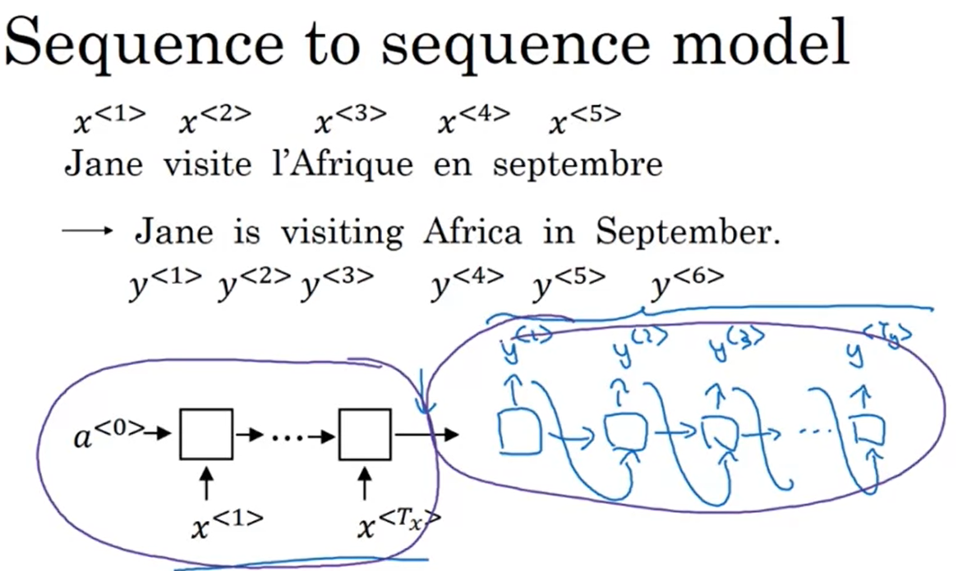

Slide 3
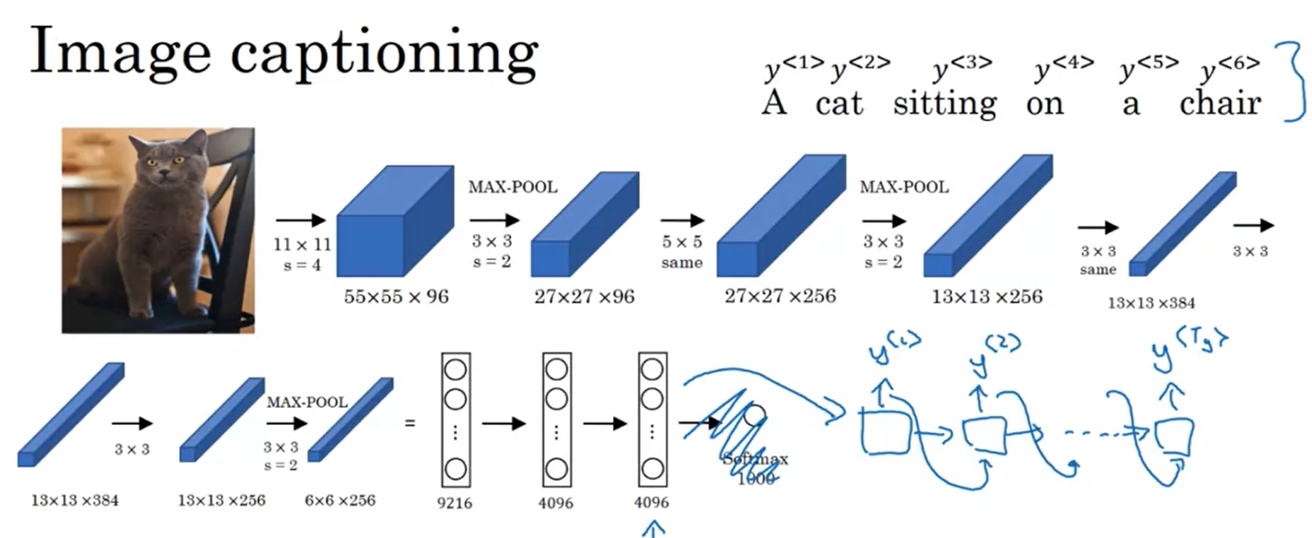

Slide 4
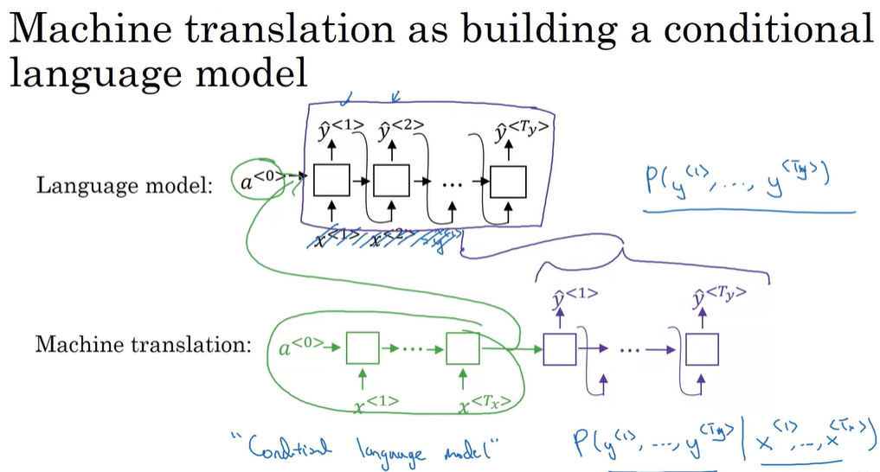

Slide 5
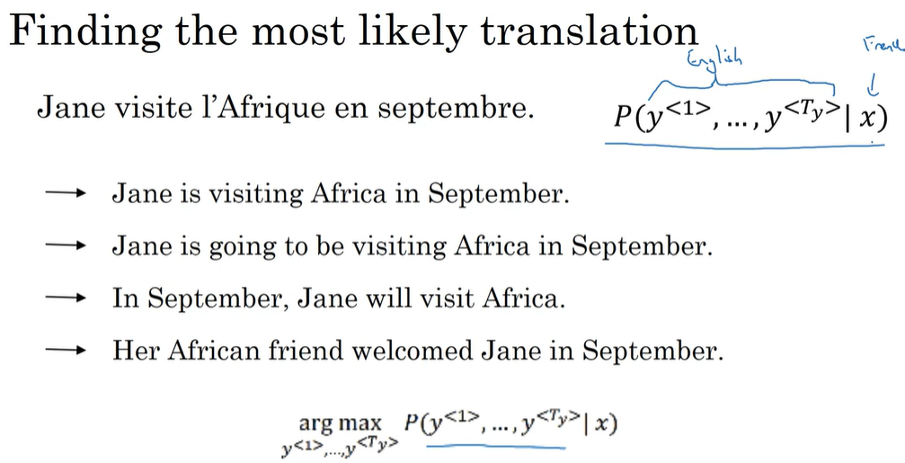

Slide 6
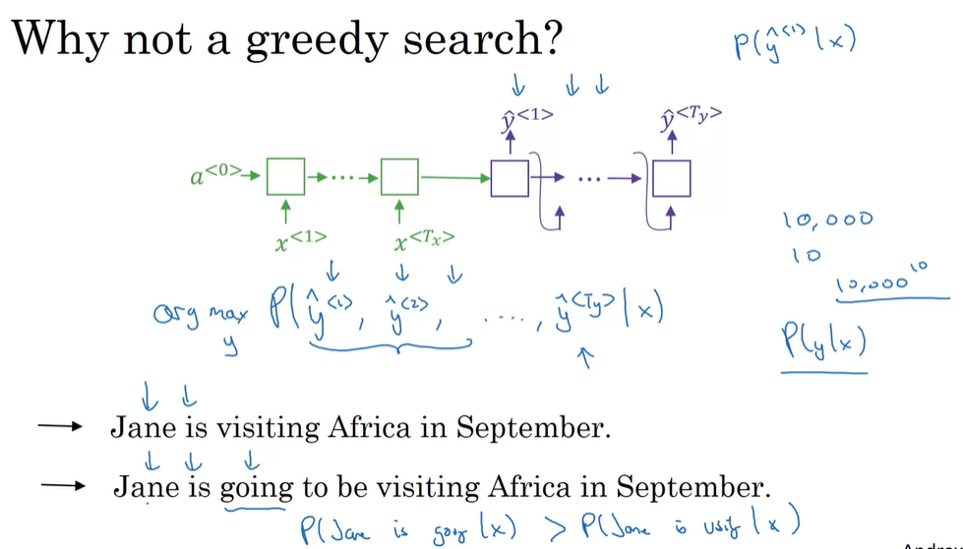

Slide 7
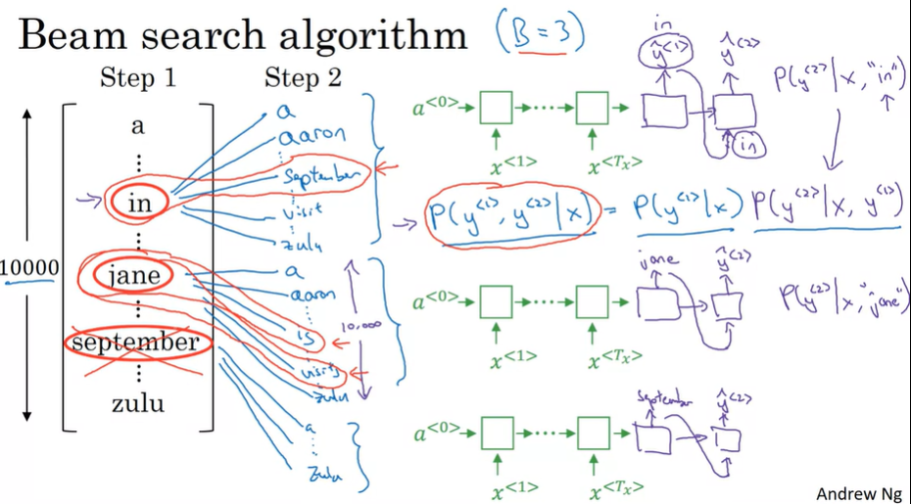

Slide 9
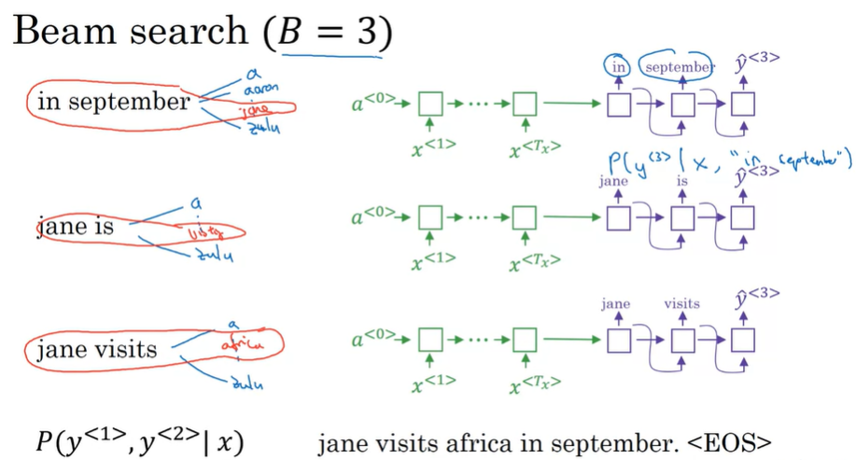

Slide 10
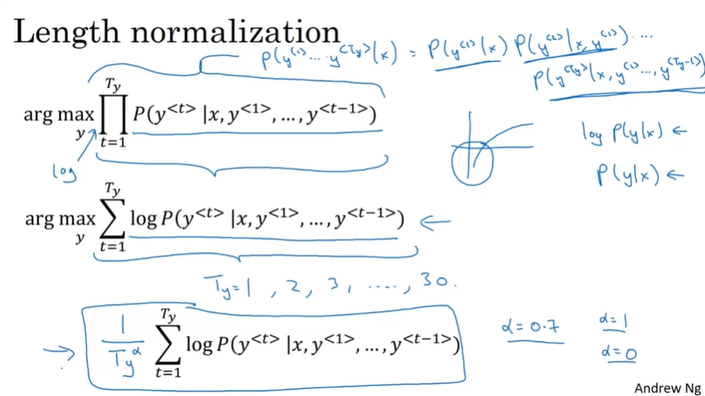
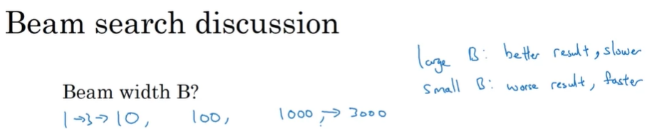

There will be 3 (number of beams) sentences for each of the lengths, use normalized probability to compare the result of different length.

Slide 11
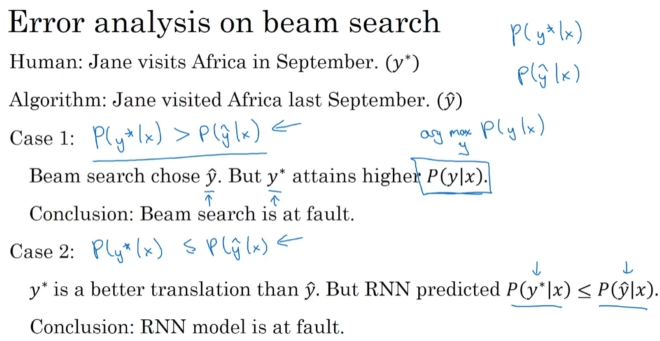

Slide 12
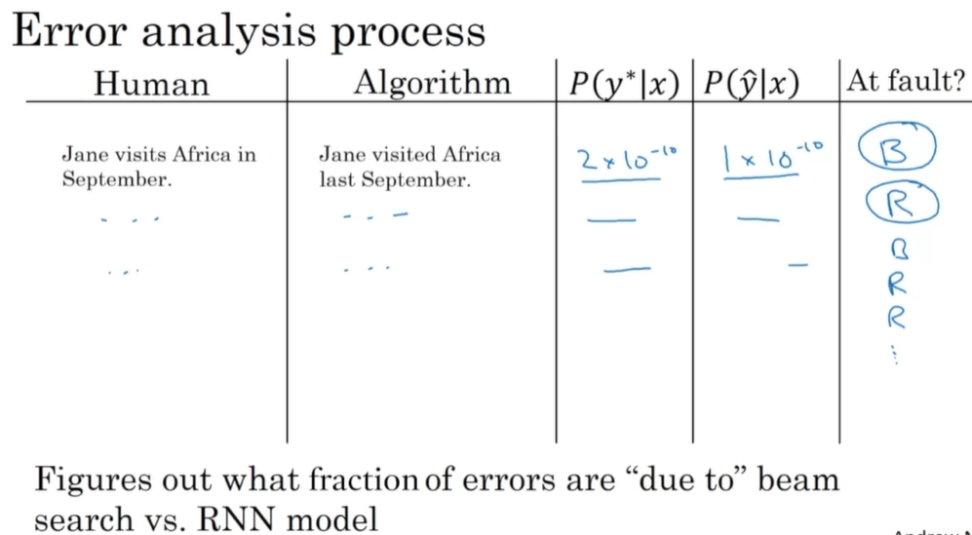

Slide 13
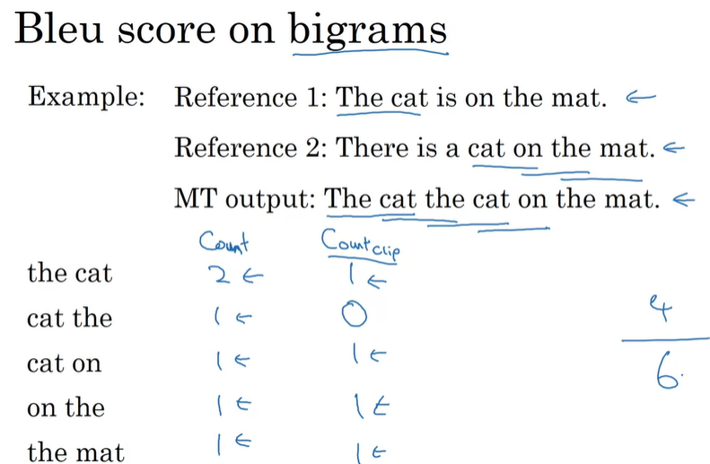
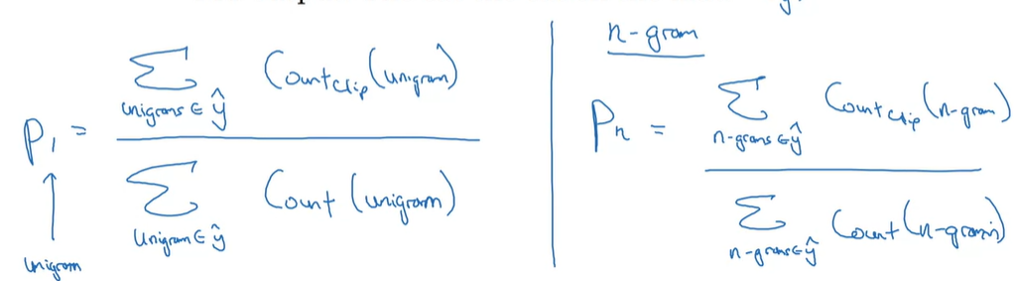



Slide 14
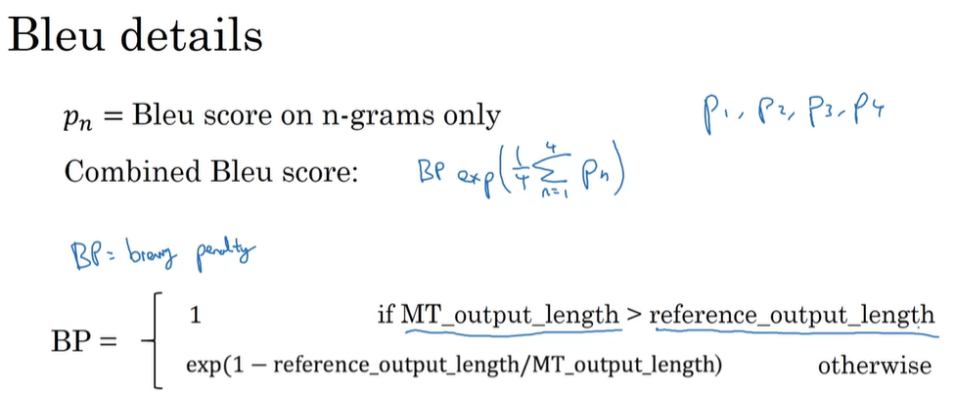

Slide 15
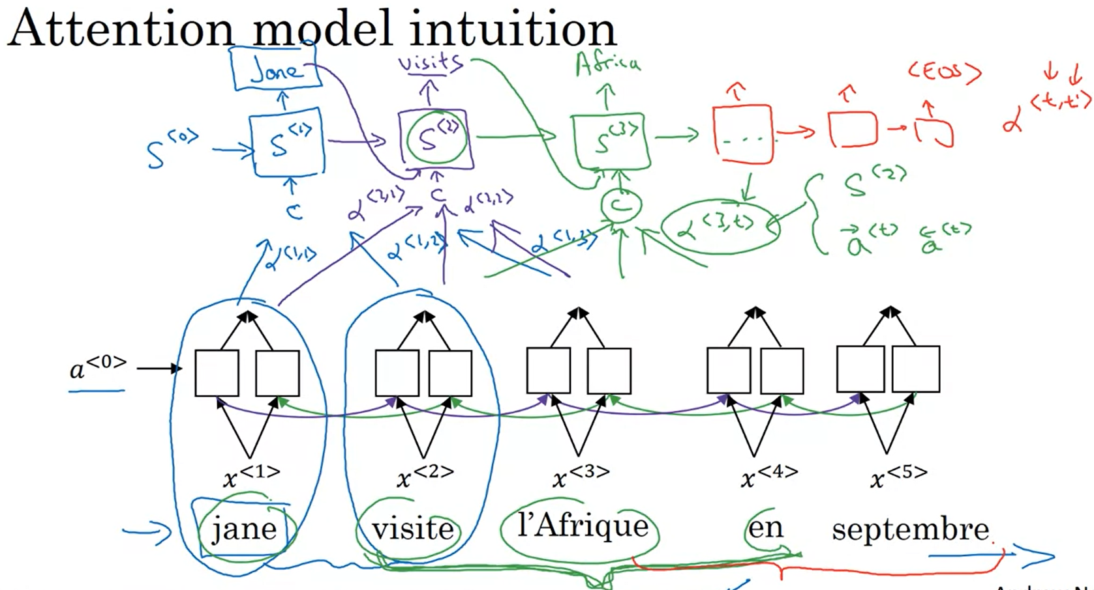

Slide 16
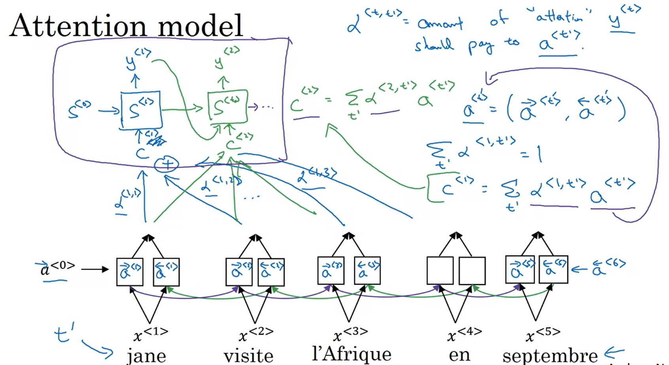
How to train?

Slide 17
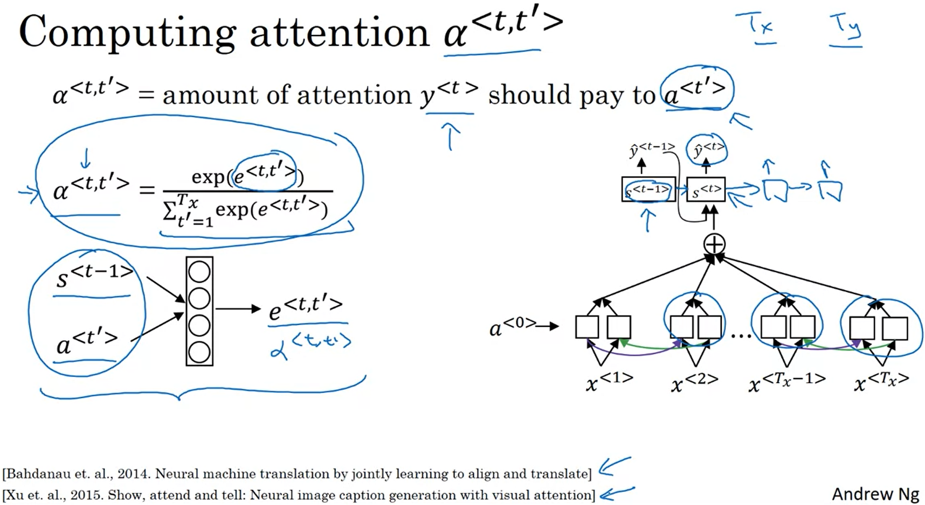

Slide 18
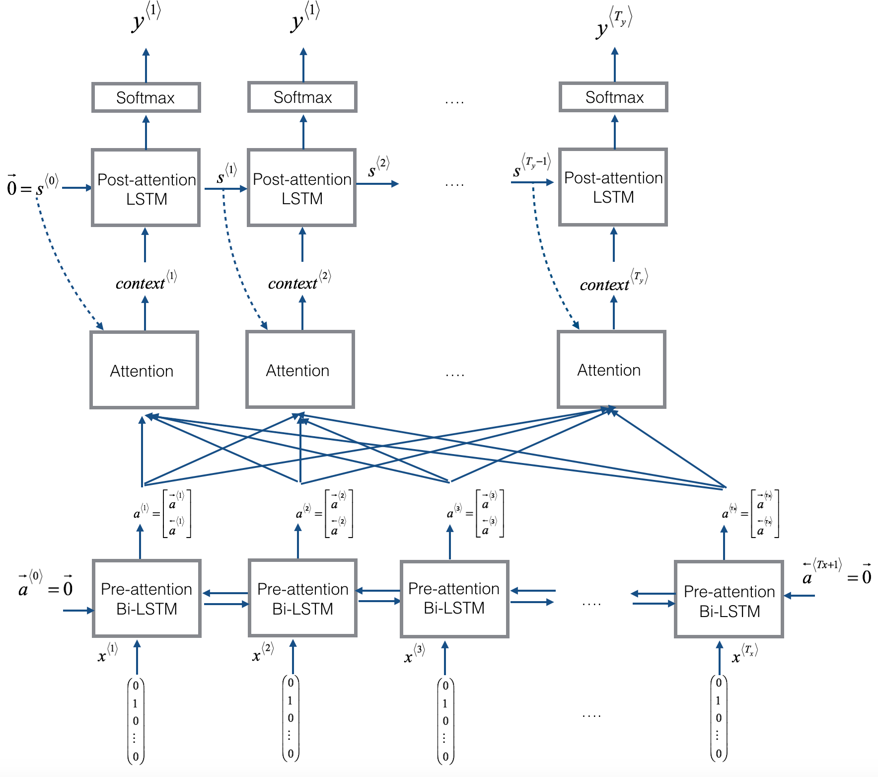
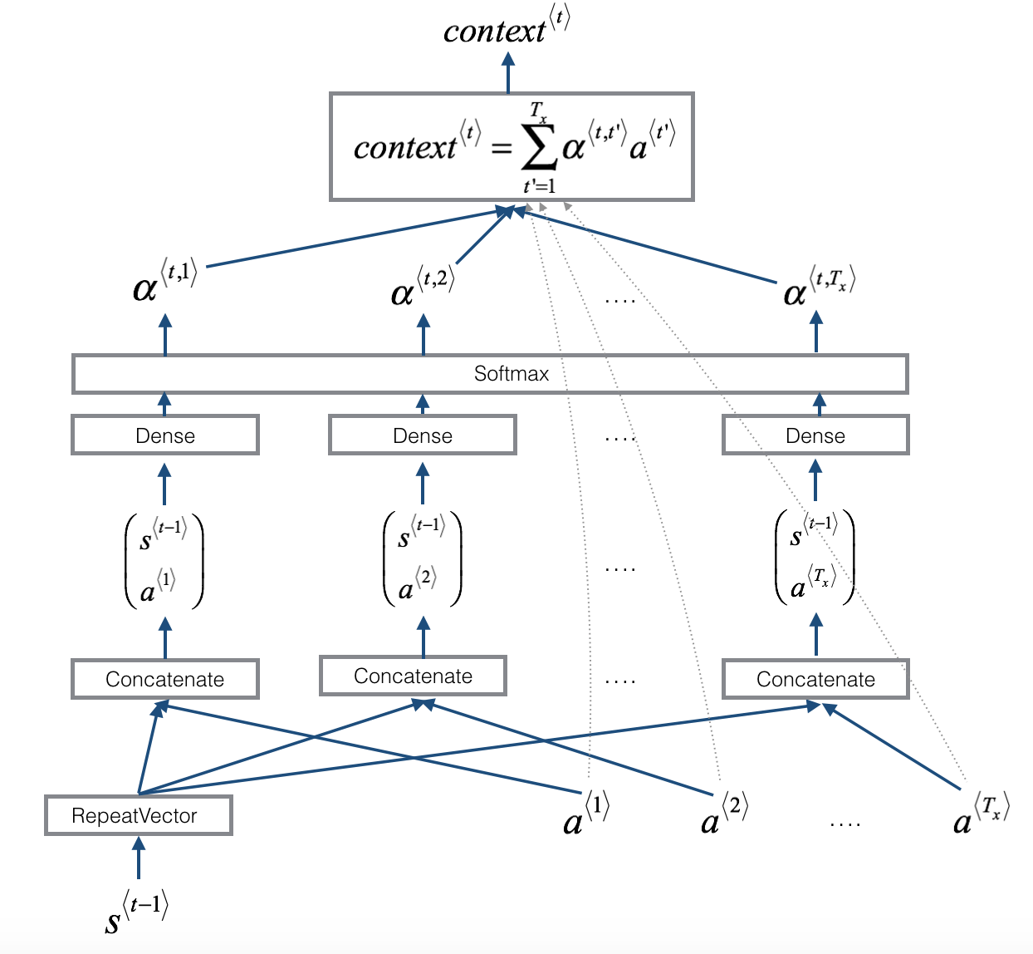
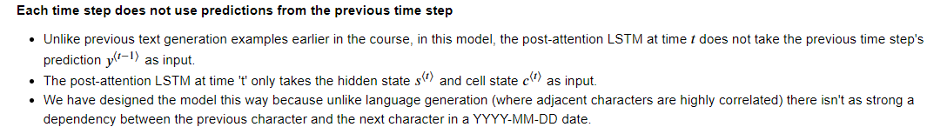

Y^<t-1> does not contribute to c^<t> ?

Slide 19
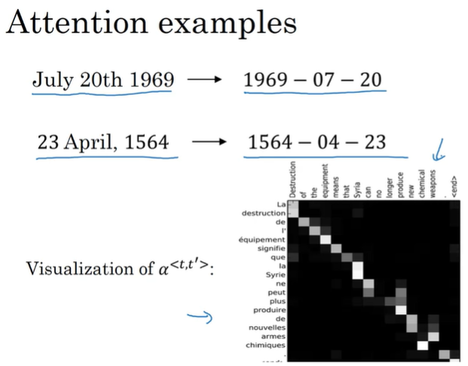

Slide 20
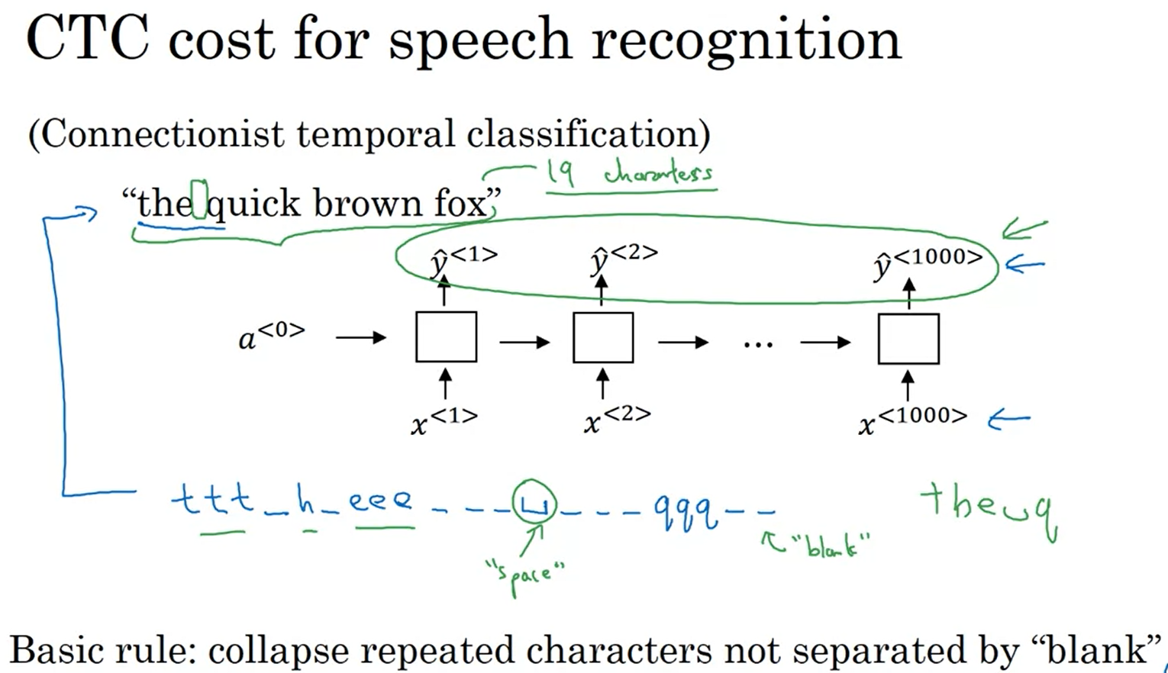

Slide 21
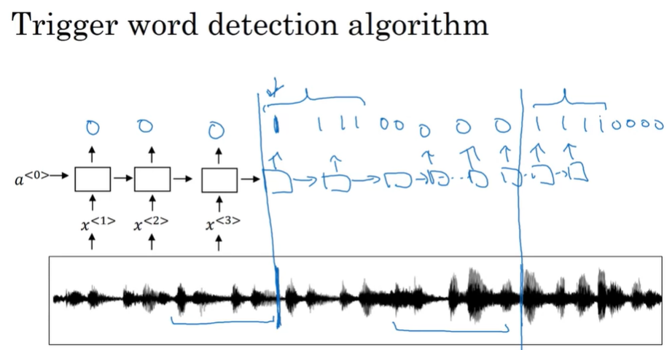

Slide 22
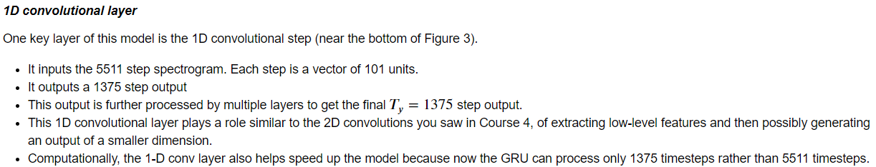
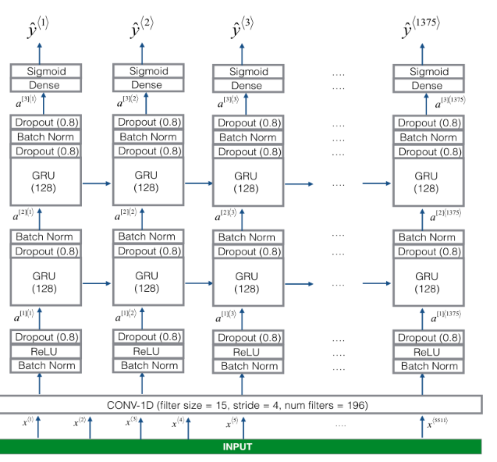
Trigger word detection modal

Slide 23
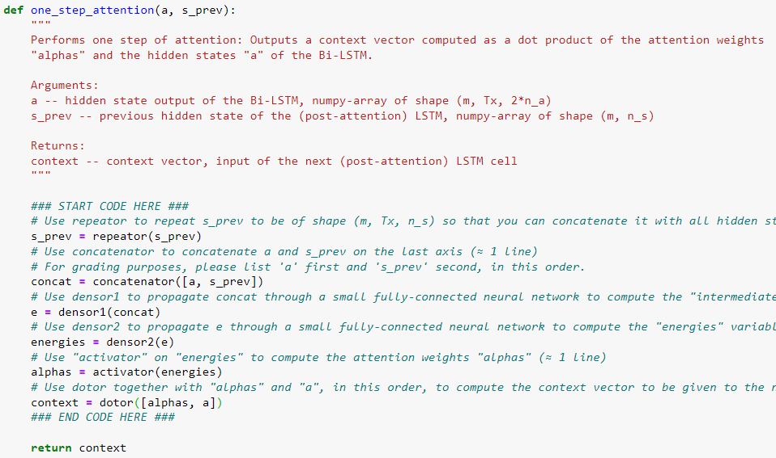
Code Exercise: Neural Machine Translation
TODO: explain the layer summary
alphas is of shape (m, Tx, 1), representing the attention weight of each word in original input Tx
a is of shape (m, Tx, 2*n_a)
A dot product along axis = 1, which means to apply weight on each of the position of Tx.
The result shape of context is therefore (m, 1, 2*n_a)

Slide 24
Calculate the number of parameters in LSTM layer
['Bidirectional', (None, 30, 64), 17920], with an input size == 37:
Meaning that for one direction (None, 30, 32),
Number of units (or dimension of hidden state is 32)
So:
4 * (32 * (37 + 32) + 32) = 8960
Multiply by 4 because LSTM has four gates.
Bi-directional equals to uni-direction LSTM, so the total number of parameter is 2*8960 = 17920.

Slide 25
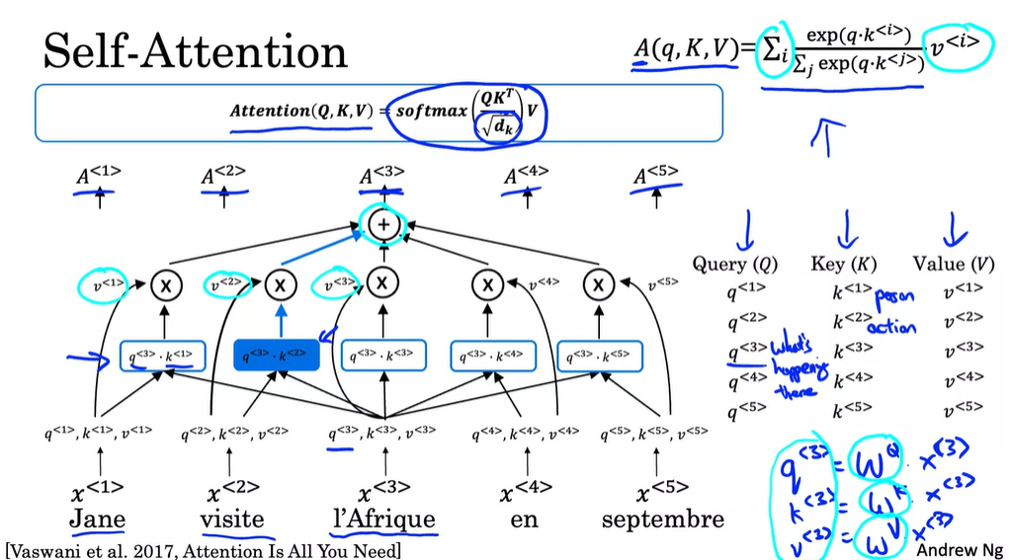

Attention weight for each word

Slide 26
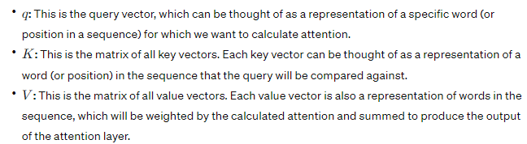
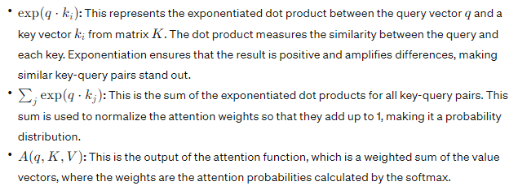
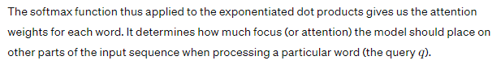
Self Attention

Slide 27
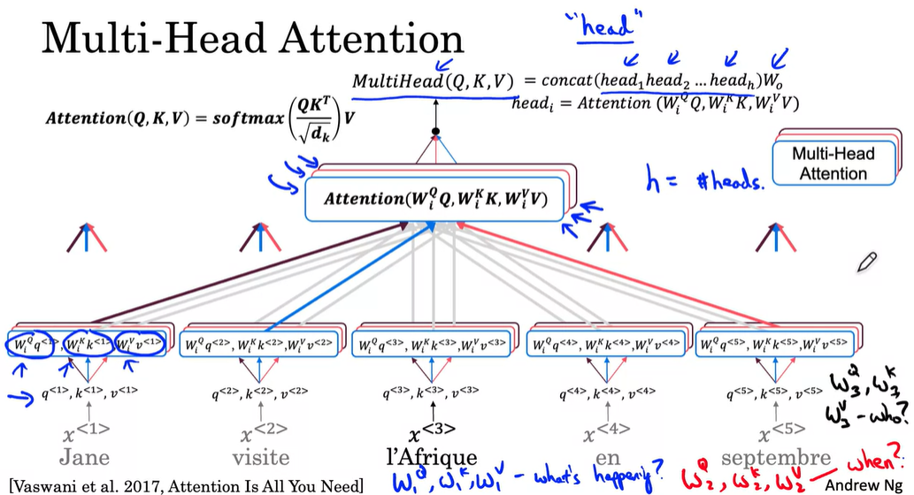

Slide 28
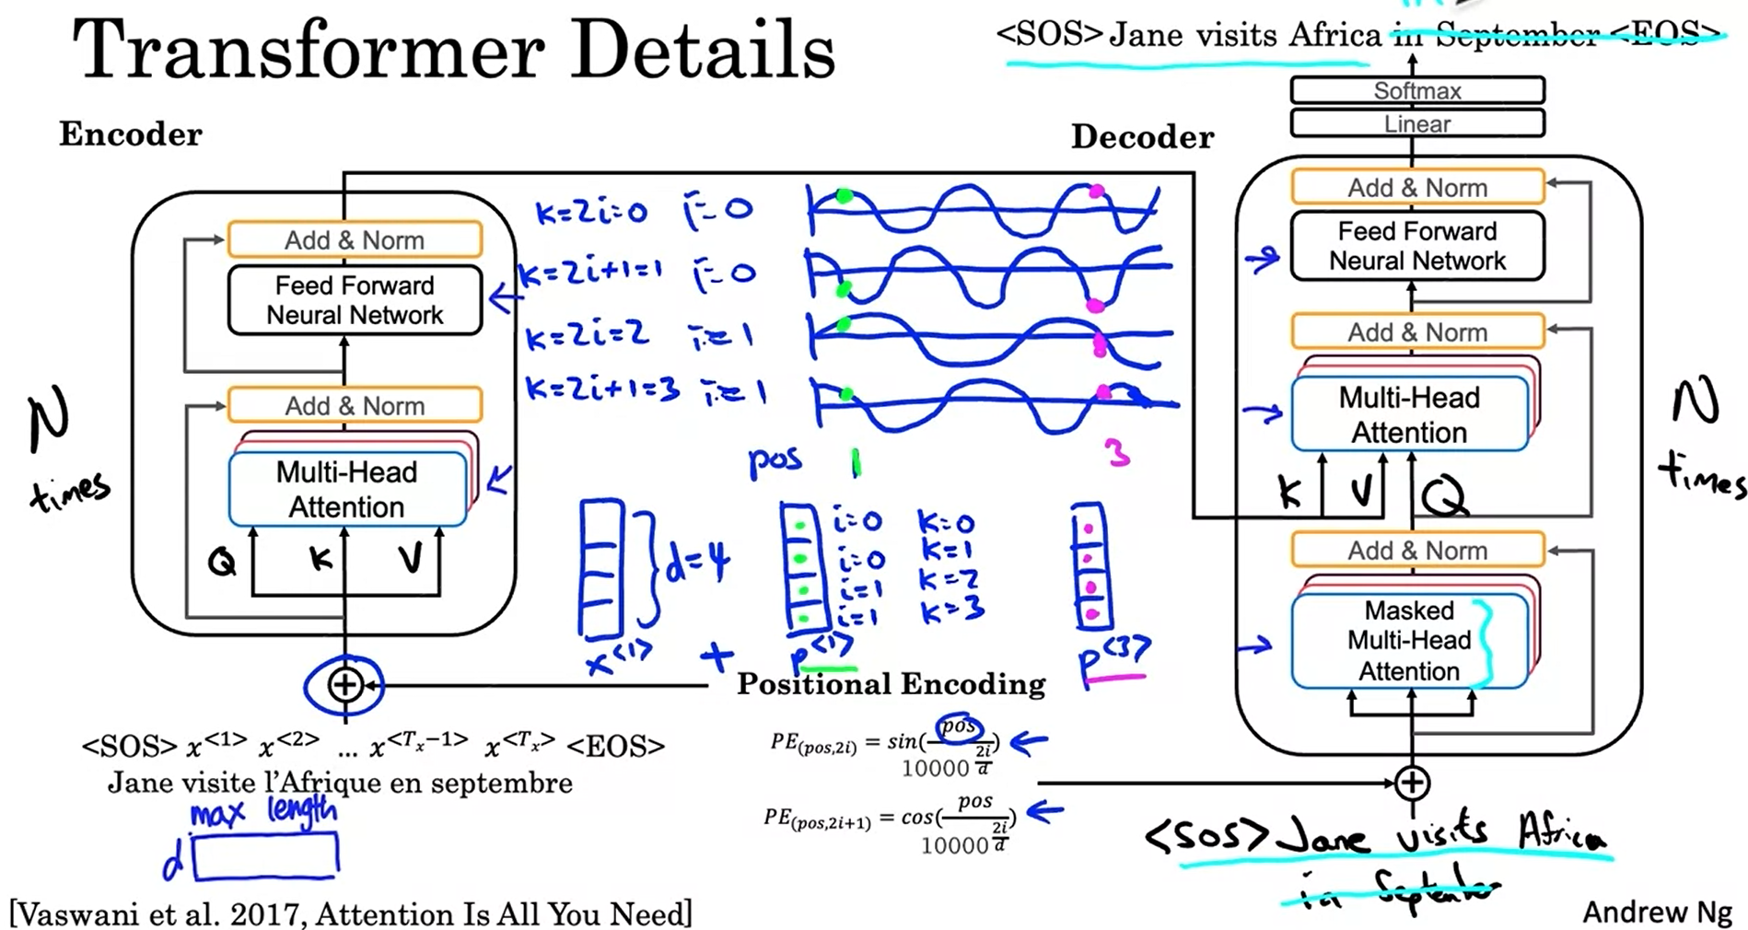



Encoder decoder attention
Encoder self-attention
Decoder self-attention

Slide 29
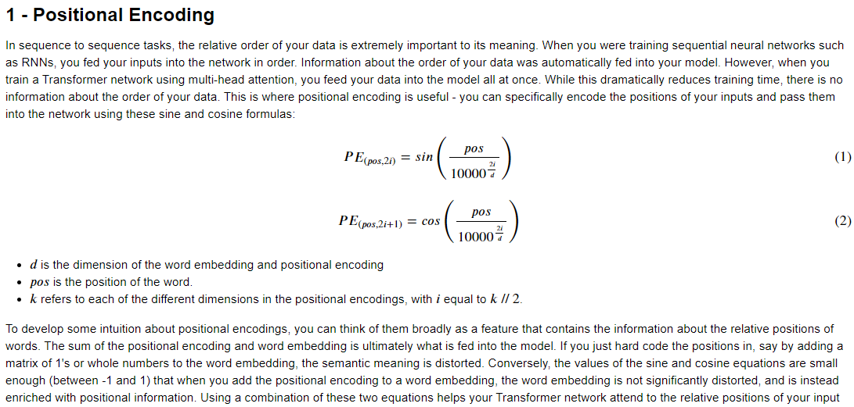

Slide 30
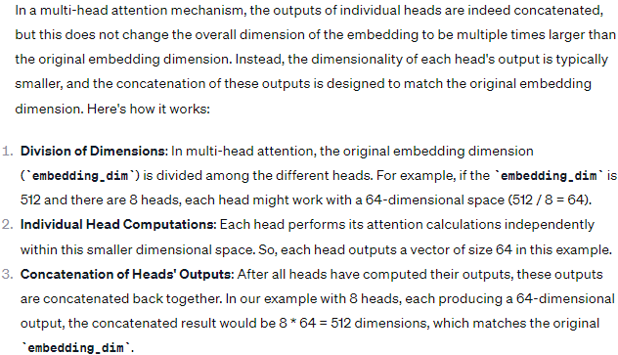
In multi-head attention, each head is concatenated to another, will it change the dimension of the embedding?

Slide 31
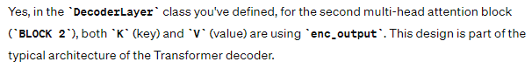
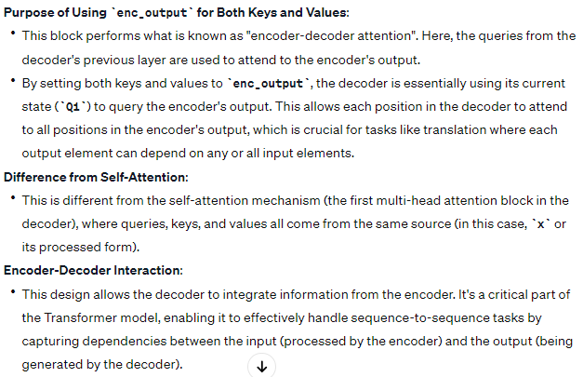

Are K and V in decoder identical?

Slide 32
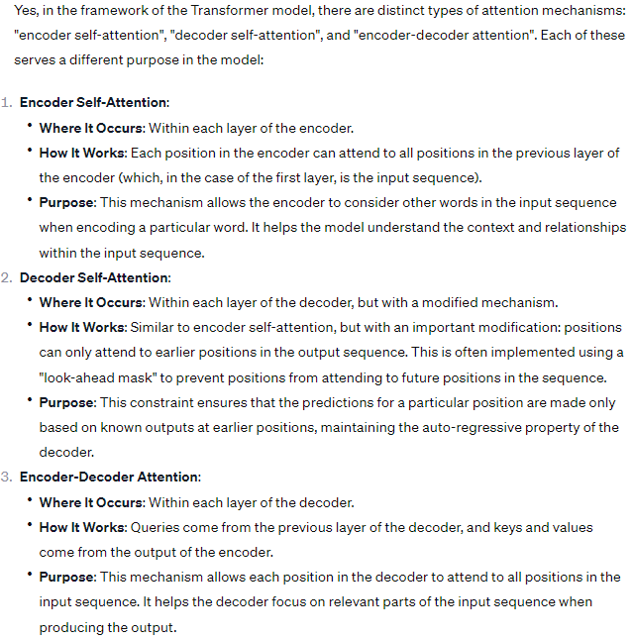

Three types of attention in Transformer

